Slide 1
We came to Toxis which was the Indian name for the Mission House. I stood just above high-tide water. The sea was in front of it and the forest behind.
The house was of wood, unpainted. There were no blinds or curtains. It looked, as we paddled up to it, as if it were stuffed with black.
Klee Wyck, “Ucluelet,” 32.

Slide 2
"Since time immemorial, we, the Gitxsan and Carrier People of kitawange, Kitseguecla, Gitanmaax, Sikadoak, Kispiox, Hagwilget and Moricetown, have exercised Sovereignty over our land. We have used and conserved the resources of our land with care and respect. We have governed ourselves. We have governed the land, the waters, the fish, and the animals. This is written on our totem poles. It is recounted in our songs and dances. It is present in our language and in our spiritual beliefs. Our Sovereignty is our Culture"
Gitxsan Carrier Declaration.

Slide 3
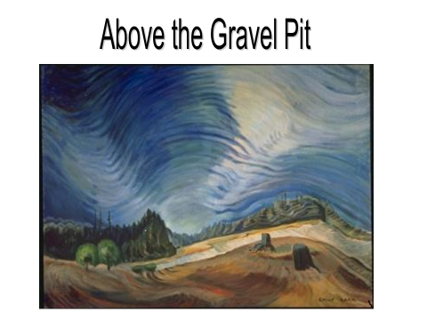

Slide 4
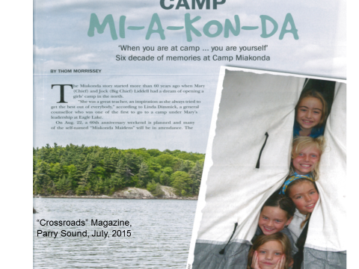

Slide 7

The Haudenosaunee Confederacy
The nations of the confederacy recognize themselves as Haudenosaunee from their own language meaning “They made the house,” symbolizing all the nations coming together as one. From east to west the original nations of the confederacy are Mohawk, Oneida, Onondaga, Cayuga and Seneca.
http://www.haudenosauneeconfederacy.com/index.html

Slide 8
I felt so young and empty standing there before the Indians and the two grave Missionaries.
32

Slide 9
After breakfast came a long Presbyterian prayer. Outside the kitchen window, just a few feet away at the edge of the forest, stood a grand balsam pine tree. It was very tall and straight.
32
The room was deathly still. Outside, the black forest Was still, too, but with a vibrant stillness tense with life. From my bed I could look one storey higher into the balsam pine. Because of his closeness to me, the pine towered above his fellows, his top tapering to heaven, like the hands of the praying Missionaries.
38

Slide 10
SUBJECT-OBJECT RELATIONSHIP
VERSUS
SUBJECT-SUBJECT RELATIONSHIP

Slide 11
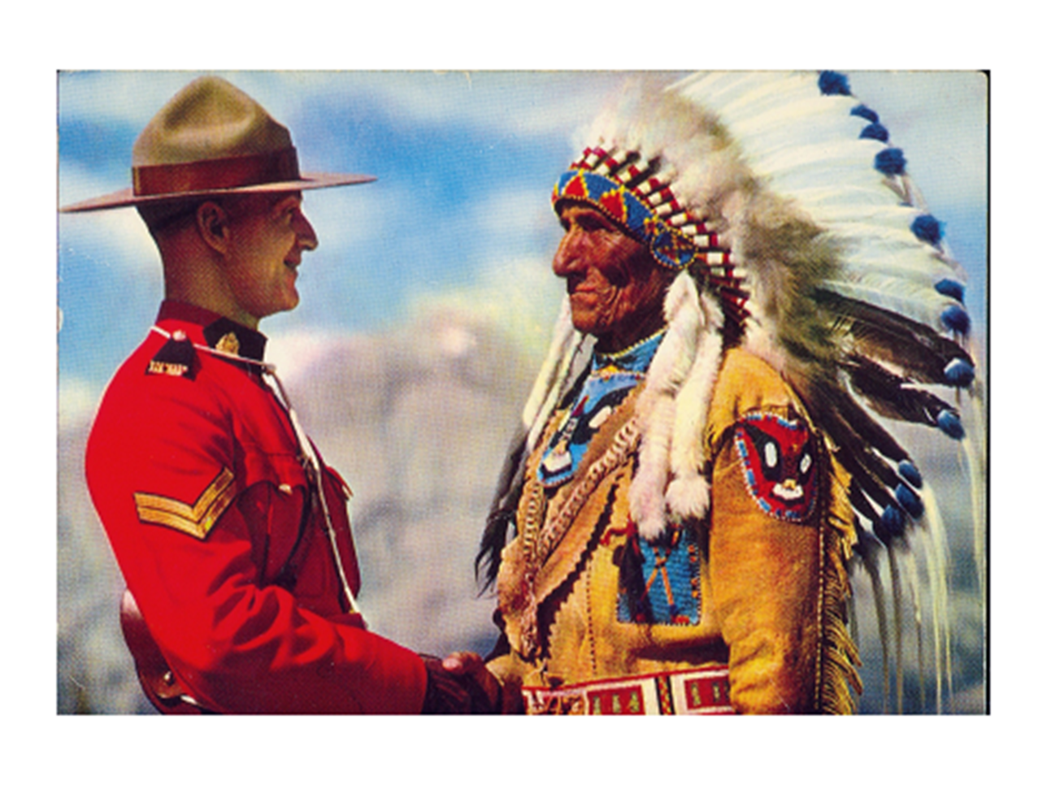

Slide 12
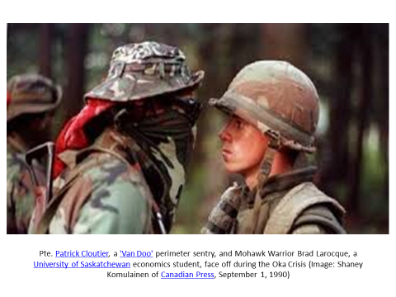

Slide 13
“Indian Reservation, Caughnawaga,” A. M. Klein, 1948
Where are the braves, the faces like autumn fruit,
who stared at the child from the coloured frontispiece?
And the monosyllabic chief who spoke with his throat?
Where are the tribes, the feathered bestiaries?—
Rank Aesop’s animals erect and red,
with fur on their names to make all things live kin’ –
Chief Running Deer, Black Bear, Old Buffalo Head?
Childhood, that wished me Indian, hoped that
one afterschool I’d leave the classroom chalk,
the varnish smell, the watered dust of the street,
to join the clean outdoors of the Iroquois track.
Childhood, but always, -- as on a calendar,--
there stood that chief, with arms akimbo, waiting
the runaway mascot paddling to his shore.
With what strange moccasin stealth that scene is changed!
With French names, without paint, in overalls,
their bronze, like their nobility expunged, --
the men.
Beneath their alimentary shawls
sit like black tents their squaws; while for the tourist’s brown pennies scattered at the old church door,
the ragged papooses jump, and bite the dust.
Their past is sold in a shop: the beaded shoes,
the sweetgrass basket, the curio Indian,
burnt wood and gaudy cloth and inch-canoes –
trophies and scalpings for a traveller’s den.
Sometimes, it’s true, they dance, but for a bribe;
after a deal don the bedraggled feather
and welcome a white mayor to the tribe.
This is a grassy ghetto, and no home.
And these are fauna in a museum kept.
The better hunters have prevailed. The game,
losing its blood, now ,makes these grounds its crypt.
The animals pale, the shine of the fur is lost,
bleached are their living bones. About them watch
As through a mist, the pious prosperous ghosts.
.

Slide 14
